Slide 1
The Wounds of the Past,
Truth-telling and A Future of Hope: The Doctrine of Discovery and the Path of Reconciliation
Presentation by
Archbishop Donald Bolen
Braiding Together Conference
Banff, Oct. 13, 2023

Slide 2
Outline:
The legacy of colonization
The doctrine of discovery, the papal bulls of the 15th/16th centuries, and the TRC request to address historical justification for the taking of Indigenous-occupied lands
The CCCB 2016 document on the doctrine of discovery
Analyzing the Holy See statement of March 2023: what it says, what it doesn’t say, response to the statement
The call for a symposium on the doctrine of discovery
Where does the conversation go from here?
Understanding the 15th/16th c. better; the intentions of the Church, the intentions of the colonizers;
What is the ongoing impact of colonization and the doctrine of discovery today?
What can the church do?
What can teachers do?

Slide 3
“To some people, reconciliation is the re-establishment of a conciliatory state. However, this is a state that many Aboriginal people assert never has existed between Aboriginal and non-Aboriginal people…. Reconciliation must support Aboriginal peoples as they heal from the destructive legacies of colonization that have wreaked such havoc in their lives.”
-Honouring the Truth, Reconciling for the Future: Summary of the Final Report of the Truth and Reconciliation Commission of Canada pp. 6, 8.

Slide 4
“I say this to you with regret: many grave sins were committed against the native peoples of America in the name of God.… Like Saint John Paul II, I ask that the Church – I repeat what he said – ‘kneel before God and implore forgiveness for the past and present sins of her sons and daughters’… I humbly ask forgiveness, not only for the offenses of the Church herself, but also for crimes committed against the native peoples during the so-called conquest of America.”
-Pope Francis address to Second World Meeting of Popular Movements, July 9, 2015

Slide 5
“The chain that passed on knowledge and ways of life in union with the land was broken by a colonization that lacked respect for you, tore many of you from your vital milieu and tried to conform you to another mentality. In this way, great harm was done to your identity and your culture, many families were separated, and great numbers of children fell victim to these attempts to impose a uniformity based on the notion that progress occurs through ideological colonization….”
-Pope Francis, Meeting with Indigenous Delegations in Rome, April 1, 2022

Slide 6
“I am here because the first step of my penitential pilgrimage among you is that of again asking forgiveness, of telling you once more that I am deeply sorry. Sorry for the ways in which, regrettably, many Christians supported the colonizing mentality of the powers that oppressed the indigenous peoples. I am sorry. I ask forgiveness, in particular, for the ways in which many members of the Church and of religious communities cooperated, not least through their indifference, in projects of cultural destruction and forced assimilation promoted by the governments of that time, which culminated in the system of residential schools.”
-Pope Francis, address at Maskwacis, Alberta, July 25, 2022

Slide 7
“Although Christian charity was not absent, and there were many outstanding instances of devotion and care for children, the overall effects of the policies linked to the residential schools were catastrophic.”
-Pope Francis, Maskwacis
“That ‘history of suffering and contempt’, the fruit of the colonizing mentality, ‘does not heal easily’.”
-Pope Francis, Citadelle de Québec, July 27, 2022

Slide 8
Call to Action 49:
We call upon all religious denominations and faith groups who have not already done so to repudiate concepts used to justify European sovereignty over Indigenous lands and peoples, such as the Doctrine of Discovery and terra nullius.

Slide 9
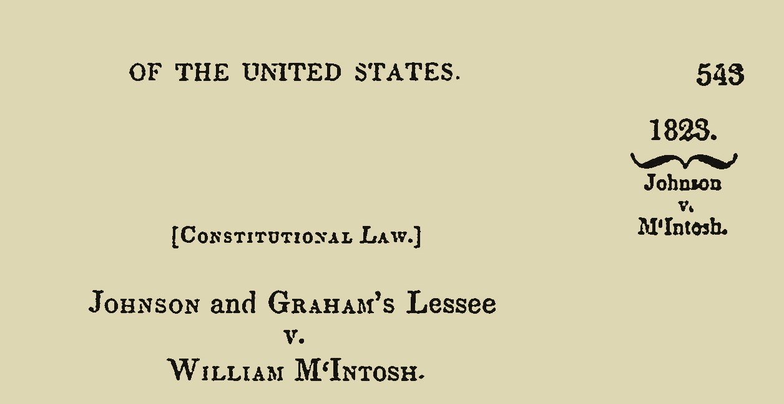
Header from pg 1:
https://tile.loc.gov/storage-services/service/ll/usrep/usrep021/usrep021543/usrep021543.pdf

Slide 10
“On the discovery of this immense continent, the great nations of Europe were eager to appropriate to themselves so much of it as they could respectively acquire.... But, as they were all in pursuit of nearly the same object, it was necessary, in order to avoid conflicting settlements, and consequent war with each other, to establish a principle, which all should acknowledge as the law by which the right of acquisition, which they all asserted, should be regulated as between themselves. This principle was, that discovery gave title to the government by whose subjects, or by whose authority, it was made, against all other European governments, which title might be consummated by possession.”

Slide 11
“In the establishment of these relations, the rights of the original inhabitants were, in no instance, entirely disregarded; but were necessarily, to a considerable extent, impaired…. their power to dispose of the soil at their own will, to whomsoever they pleased, was denied by the original fundamental principle, that discovery gave exclusive title to those who made it.”
-Johnson vs. McIntosh, 1923

Slide 12
“We grant you by these present documents, with our Apostolic Authority, full and free permission to invade, search out, capture, and subjugate the Saracens and pagans and any other unbelievers and enemies of Christ wherever they may be, as well as their kingdoms, duchies, counties, principalities, and other property... and to reduce their persons into perpetual servitude.”
-Dum Diversas, 1452

Slide 13
“…should any of said islands have been found by your envoys and captains, give, grant, and assign to you and your heirs and successors, kings of Castile and Leon, …all rights, jurisdictions, and appurtenances, all islands and mainlands found and to be found, discovered and to be discovered towards the west and the south, by drawing and establishing a line from the Arctic pole, namely the north, to the Antarctic pole, namely the south, … the said line to be distant one hundred leagues towards the west and south from any of the islands commonly known as the Azores and Cape Verde.”
-Inter Cetera, 1493

Slide 14
“…we hereby define and declare …that the aforementioned Indians and all other nations who may later come to the notice of Christians, even if they are without faith in Christ, are not, and shall not be, deprived of their freedom nor of their dominion over their property, indeed, they are able to freely and lawfully enjoy the use and possession of this dominion and freedom. Neither should they be reduced to slavery. And should anything to the contrary occur it is rendered null and void and of no force or effect.”
- Sublimis Deus, Pope Paul III, 1537

Slide 15
We therefore declare the following:
We firmly assert that Indigenous people, created in the image and likeness of God our Creator, should have been granted all fundamental human rights in the past as in the present, and that any reducing of their humanity and fundamental human rights past or present is to be resisted in the strongest possible way;
2. We reject the assertion that the ancient principle of the first taker or discoverer, often described by the term terra nullius, could be applied to lands in the prior possession of Indigenous Peoples;

Slide 16
We reject the assertion that the mere absence of European agricultural practices, technologies, or other aspects common to European culture, could justify the claiming of land as if it had no owner;
We reject the assertion that Europeans could determine whether land was used or possessed by Indigenous people without consulting those people.
-2016 statement of the Guadalupe Circle on the Doctrine of Discovery

Slide 17
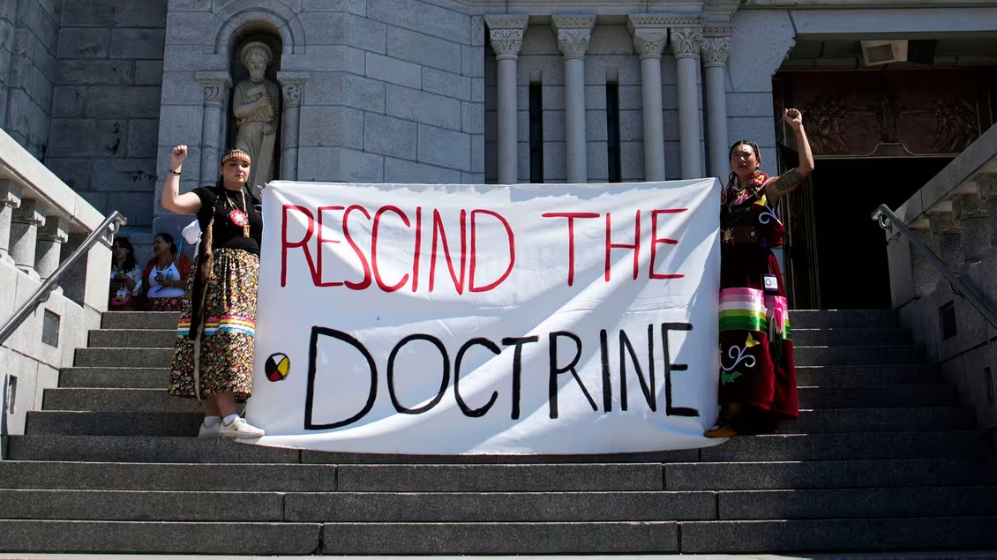

Slide 18
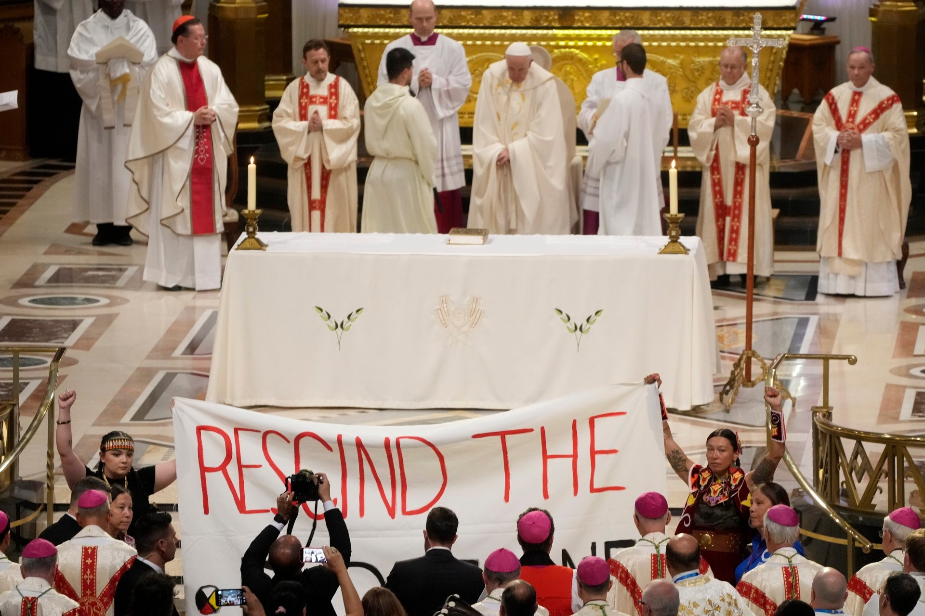

Slide 19
“The ‘doctrine of discovery’ is not part of the teaching of the Catholic Church. Historical research clearly demonstrates that the papal documents in question, written in a specific historical period and linked to political questions, have never been considered expressions of the Catholic faith. At the same time, the Church acknowledges that these papal bulls did not adequately reflect the equal dignity and rights of indigenous peoples. The Church is also aware that the contents of these documents were manipulated for political purposes by competing colonial powers in order to justify immoral acts against indigenous peoples that were carried out, at times, without opposition from ecclesiastical authorities.”

Slide 20
“It is only just to recognize these errors, acknowledge the terrible effects of the assimilation policies and the pain experienced by indigenous peoples, and ask for pardon. Furthermore, Pope Francis has urged: ‘Never again can the Christian community allow itself to be infected by the idea that one culture is superior to others, or that it is legitimate to employ ways of coercing others.’”
-Joint Statement of the Dicasteries for Culture and Education and for Promoting Integral Human Development on the “Doctrine of Discovery”, March 30, 2023

Slide 21
“The history of America, from its discovery to the present day, proves, we think, the universal recognition of these principles. Spain did not rest her title solely on the grant of the Pope. Her discussions respecting boundary, with France, with Great Britain, and with the United States, all show that she placed in on the rights given by discovery. Portugal sustained her claim to the Brazils by the same title. France, also, founded her title to the vast territories she claimed in America on discovery.”
-Johnson vs. McIntosh, 1923

Slide 22
Remaining questions:
What role did the papal bulls play in the decisions of the colonizing powers?
What is the ongoing impact of colonization and the doctrine of discovery today?
What can the church do?
What can our schools and teachers do? Task and complexity of truth-telling

Slide 23
Words written by Pope Francis in the visitors book at the Basilica in Québec City:
« Marcher ensemble, ce n'est pas facile, mais c'est possible. »
« It is not easy to walk together, but it is possible. »

